Slide 1
Procedural Generation of Buildings
CS 334
Colin Vinarcik

Slide 2
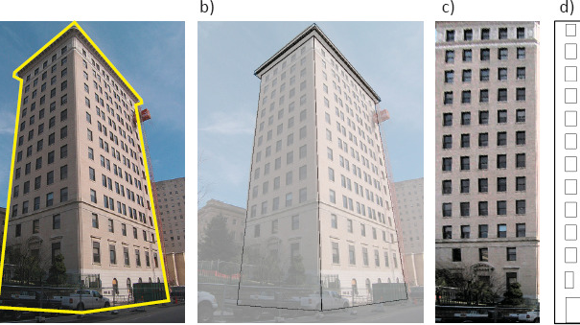
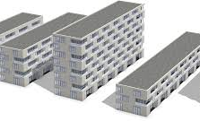
A Little Background
Goal – make a building from a file based on modify Parameters or leave random: Building height, Building Angle, Windows, floor area.
Use a basic sequential grammars, general rules to add, scale, translate, and rotate shapes.
Basic split rule: The basic split rule splits the current scope along one axis. (Used to Design Floors and Building Features).

Slide 3
Basic Grammar
Scope (x;y;z) - set the scope of a new geometry object
Divide(x,y,z)[object,object] – divide the object and give the set the outcome to differet variables
Translate(x,y,z) – used to translate an object somewhere in the world space
Repeat(x,y) [object] – given a object repeat last command with variables for given number of times
GeometryDraw(objectType)[image] – draw the give object, and use give image if it exists

Slide 4

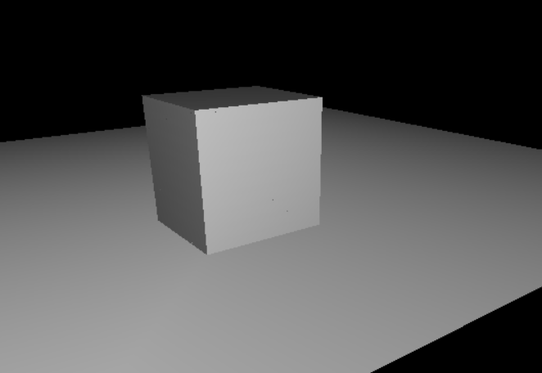
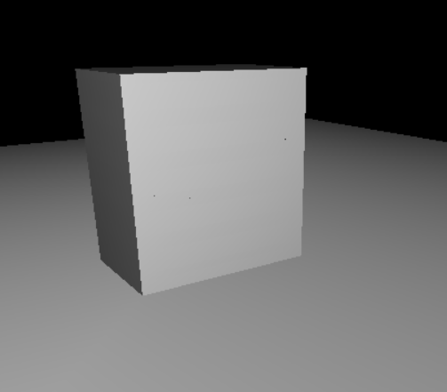
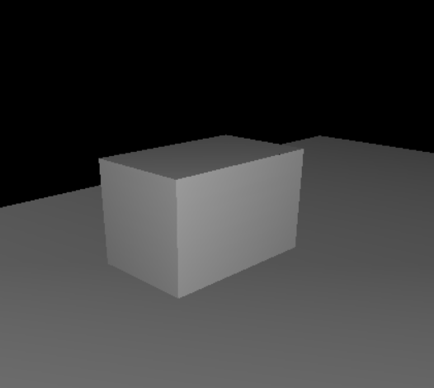
First Step
Make a Parser to read a grammer from an input file.
Use the give rule parsed in to generate a 3d world (first with no textures on objects)
Add randomization of the rules to make a diverse set of possible buildings
Basic Cube
Randomized Basic Cube

Slide 5
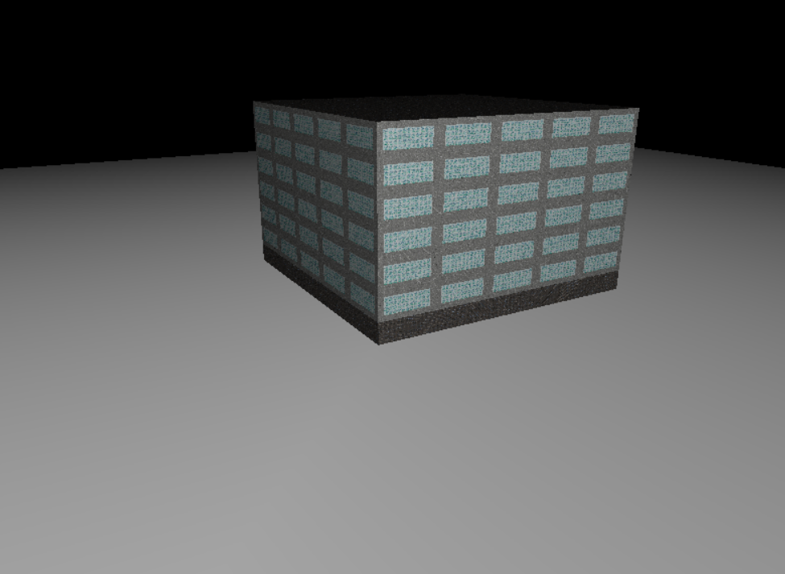
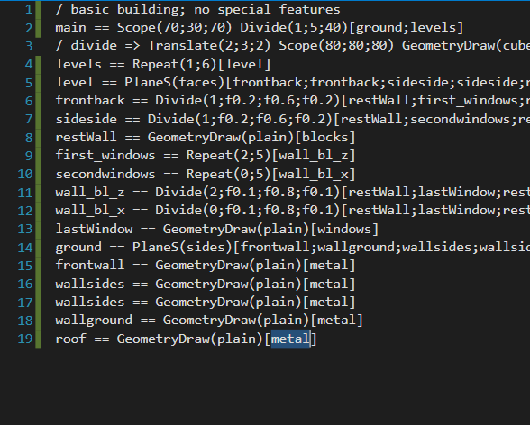
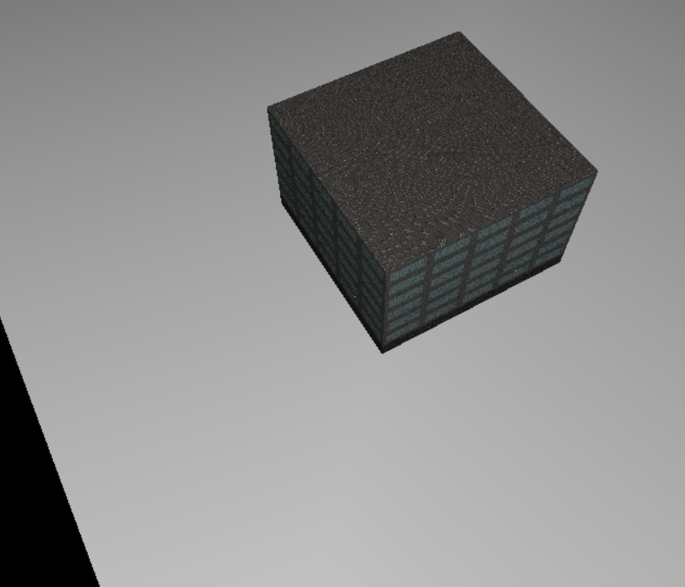
Addition of Textures
Implanting Textures, and spiting of objects
Allows for different parts of the building to have different textures, such as adding windows

Slide 6
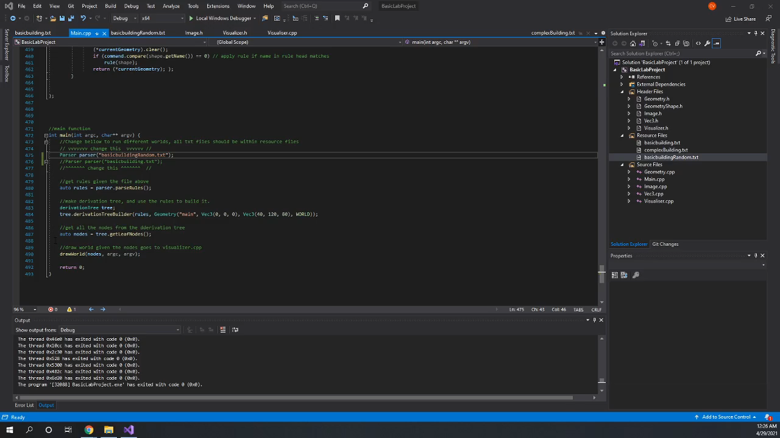
Demo

Slide 7
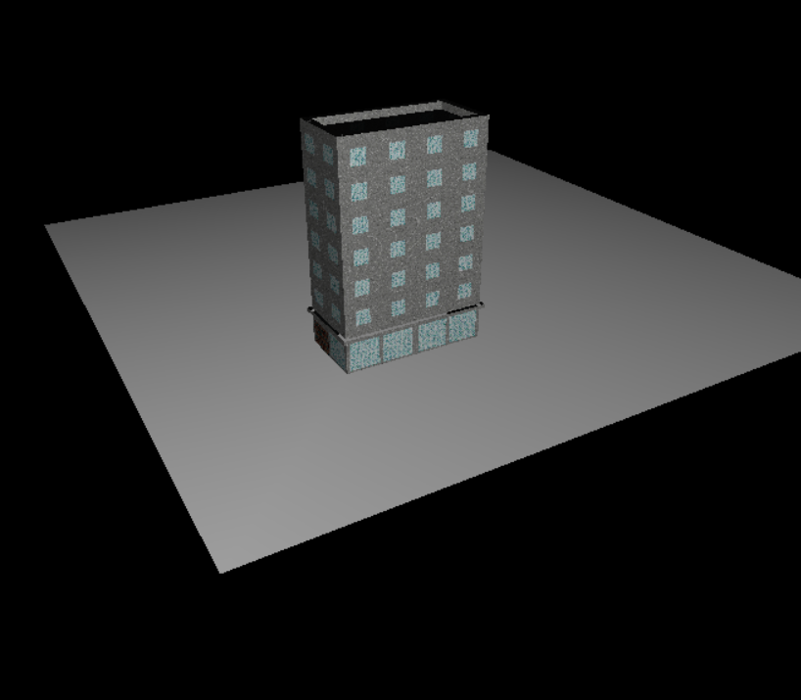
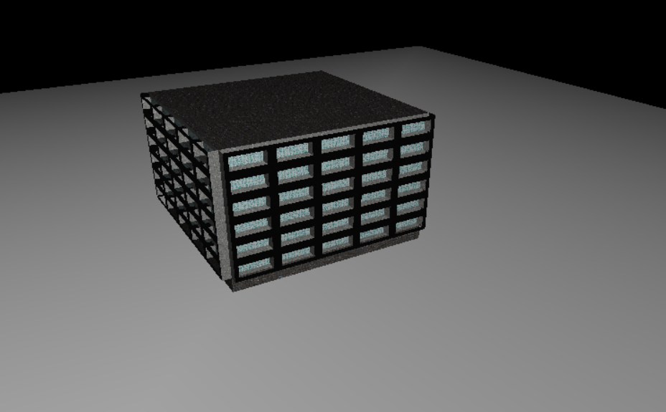
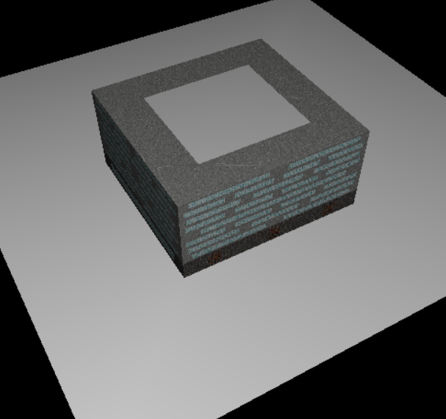
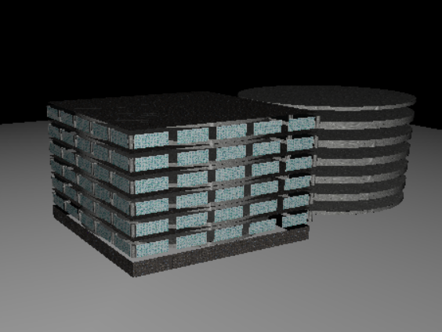
Some more Examples

Slide 8
Sources
Alkaim, A. (n.d.). Procedural Generation for Architecture. http://web.ist.utl.pt/antonio.menezes.leitao/Rosetta/FinalReport/reports/ArturAlkaim-Report.pdf.
Muller, P., Wonka, P., Haegler, S., Ulmer, A., & Gool, L. V. (2004). Procedural Modeling of Buildings. http://peterwonka.net/Publications/pdfs/2006.SG.Mueller.ProceduralModelingOfBuildings.final.pdf.
Nishida, G., Bousseau, A., & Aliaga, D. G. (2018, May 22). Procedural Modeling of a Building from a Single Image. Wiley Online Library. https://onlinelibrary.wiley.com/doi/10.1111/cgf.13372.
Procedural City Generator. Henry Dai​ ​Gameplay Programmer. (n.d.). https://www.henrydai.net/procedural-city-generator.html.

